Slide 1


SUMMER TRAINING PROJECT REPORT
TITLE :Hybrid Movie Recommendation System
Using Deep Learning with Content-Based and Collaborative Filtering

Slide 2

CONTENTS
1. INTRODUCTION
2. TRAINING OVERVIEW
3. PROJECT DETAILS
4. IMPLEMENTATION
5. RESULTS AND DISCUSSION
6. CONCLUSION

Slide 3

01
INTRODUCTION

Slide 4

Objective of the Project
The main goal of my project was to create a movie recommendation system that does two things:
• Suggest the top N movies for a user based on their past ratings, so I can get personalized suggestions.
• Find the top N movies similar to a movie I like, based on its content, like genres or themes.
Since I enjoy movies and anime, I wanted a system that feels personal and helps me discover new shows or films.
The system should be easy to use, with a web page where users can enter their ID or a movie title and get recommendations.
It uses deep learning and some part machine learning to make smart suggestions, combining what users like with movie details to give the best results possible.

Slide 5

02
TRAINING OVERVIEW

Slide 6


Tools and Technologies Used
1
Python
2
PyTorch
The main programming language I used to write all the code.
A tool for building neural networks, which I used for my recommendation model.
3
Pandas and NumPy
4
Scikit-learn
For working with data, like organizing movie ratings and details.
For splitting data, scaling numbers, and checking how well the model works.
5
Flask
6
Matplotlib
To create a web page where users can get movie recommendations.
For making graphs to show the model’s results, like how close predictions are to actual ratings.

Slide 7


Areas Covered During Training
Data Preprocessing: Cleaning and preparing data so the computer can use it properly.
Supervised Learning: Teaching the computer to predict things, like movie ratings, based on examples.
Neural Networks: Building models that act like a brain to find patterns in data, which I used for my recommendation system.
Recommendation Systems: Learning how to suggest items based on what users like or item details, like movie genres.
Model Evaluation: Checking if the model’s predictions are good using numbers like error rates.
Web Deployment: Putting the model online so users can interact with it through a web page.

Slide 8

03
PROJECT DETAILS

Slide 9
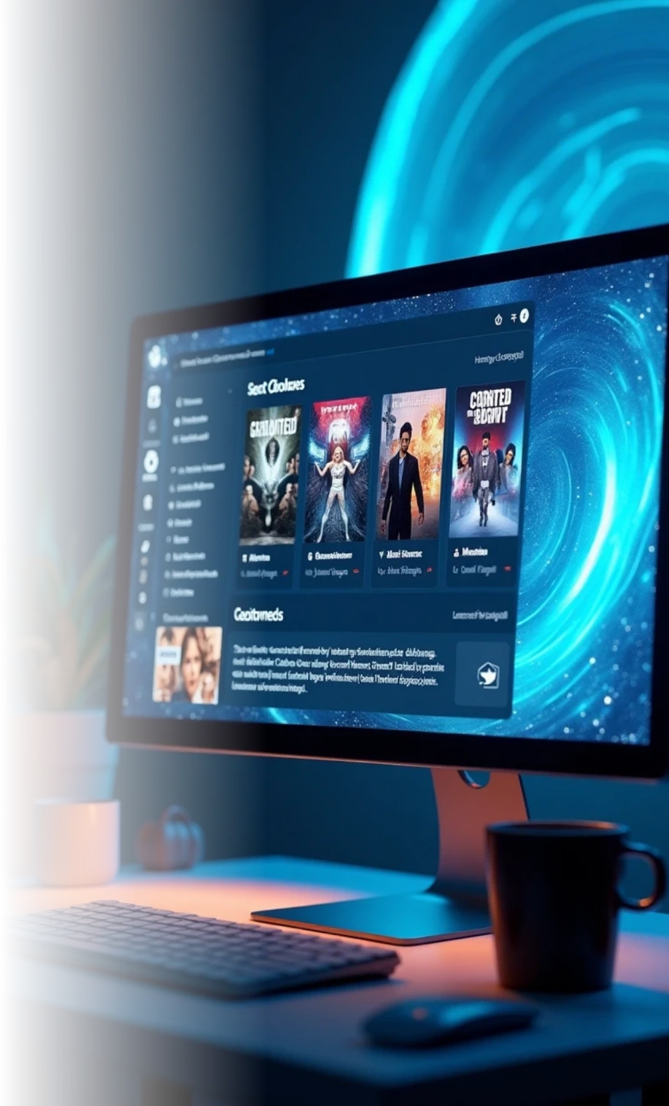
Title of the Project
Hybrid Movie Recommendation System Using Deep Learning with Content-Based and Collaborative Filtering

Slide 10


Problem Definition
There are so many movies and anime shows out there, it’s hard to find ones you’ll really like.
Some recommendation systems only look at what you’ve rated, but they might miss movies that are similar in style or theme.
Others only look at movie details but don’t consider your personal tastes.
My project solves this by combining both approaches—user ratings and movie details—to give better, more personalized suggestions.
It’s designed to help people like me, who love movies and anime, find new things to watch easily.

Slide 11


Scope and Objectives
1
2
3
4
Build a system that combines collaborative filtering (based on user ratings) and content-based filtering (based on movie details like genres or descriptions).
Let users get the top N movies tailored to their tastes by entering their user ID.
Allow users to find the top N movies similar to a movie they like by entering its title.
Make the system easy to use with a web page built using Flask.

Slide 12

System Requirements
Hardware
Software
Dataset
A computer with at least 8 GB RAM. A GPU is helpful for faster training but not necessary.
Python 3.8 or higher, with libraries like PyTorch, Pandas, NumPy, Scikit-learn, Flask, and Matplotlib.
MovieLens dataset, which has files like movies.csv (movie titles and genres), ratings.csv (user ratings), and others with movie details like descriptions.

Slide 13
Architecture Diagram
1
Data Preprocessing
Loads MovieLens data, cleans it, and gets it ready for the model by turning things like user IDs and movie details into numbers.
2
Hybrid Model
A neural network that uses user ratings and movie details to predict what users might like.

Slide 14

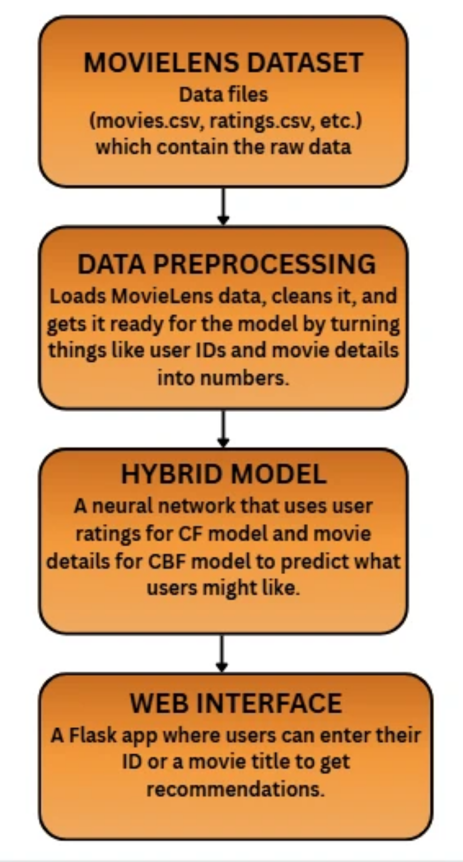
Data Flow Diagram
1
2
3
4
Load MovieLens data files (movies.csv, ratings.csv, etc.).
Clean and prepare data (encode user and movie IDs, scale ratings, extract movie features using TF-IDF).
Train the hybrid model using user ratings and movie content.
Use the model to predict ratings and suggest movies through the Flask app.

Slide 15

04
IMPLEMENTATION

Slide 16

Tools Used
I used the tools listed in Chapter 2: Python, PyTorch, Pandas, NumPy, Scikit-learn, Flask, and Matplotlib. These helped me handle data, build the model, and create a web interface for users to try the system.

Slide 17




Methodology
1
2
3
4
5
Data Preprocessing
Model Development
Training
Evaluation
Deployment
Trained the model for 10 rounds (called epochs) to make its predictions as close as possible to actual ratings, using a loss function called MSE.
Checked how good the model was using numbers like Mean Squared Error (MSE), Mean Absolute Error (MAE), and Root Mean Squared Error (RMSE).
Added a web interface with Flask so users can enter their ID or a movie title and get recommendations.
Built a neural network with PyTorch that combines user ratings (collaborative filtering) and movie details (content-based filtering) to predict ratings.
Loaded MovieLens data, filled in missing information (like empty movie descriptions), and turned user and movie IDs into numbers.

Slide 18
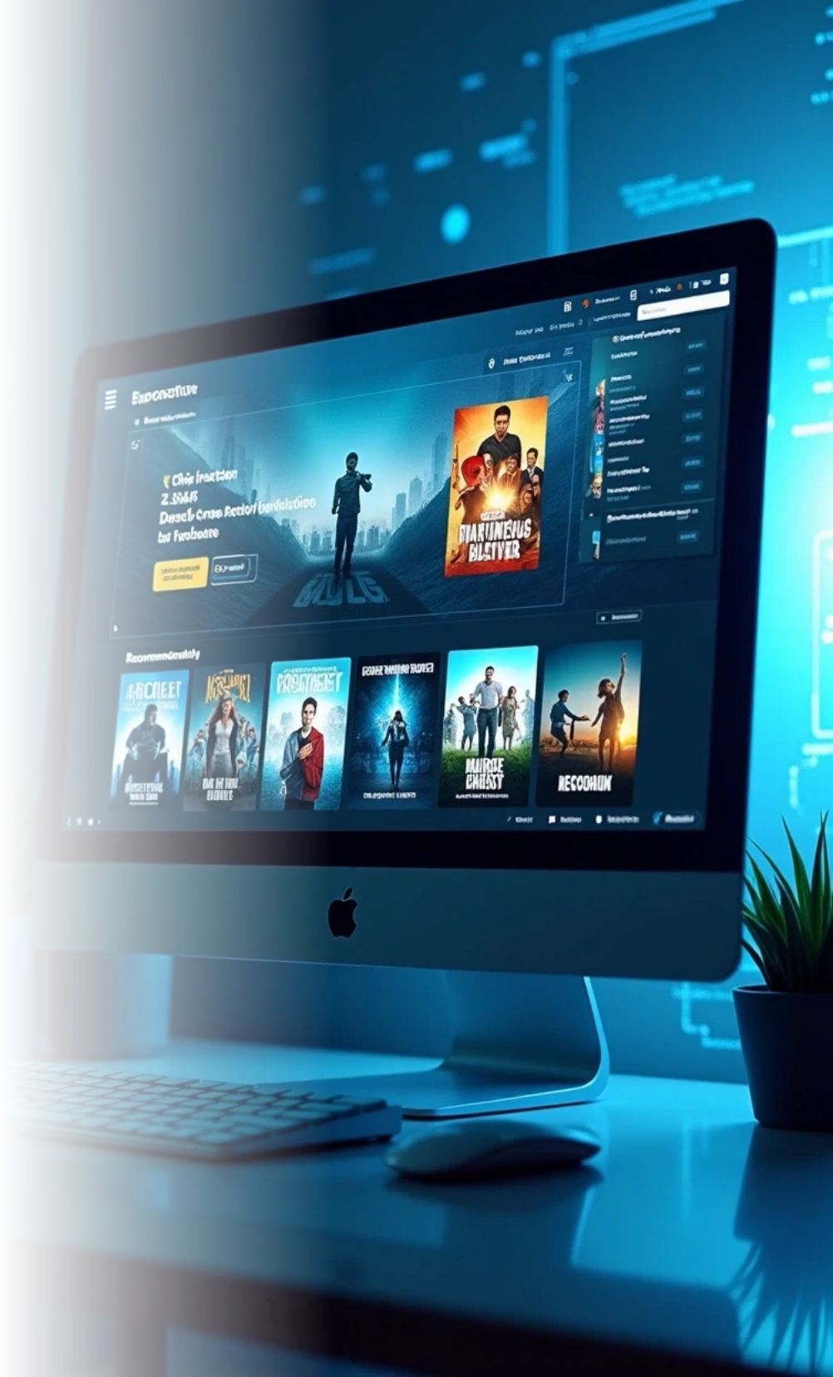


Modules
Data Loading Module: Reads and prepares MovieLens data, like cleaning it and turning it into numbers.
Model Module: The neural network that predicts ratings based on users and movies.
Recommendation Module: Suggests personalized movies or ones similar to a given title.
Web Interface Module: The Flask app where users can interact with the system.

Slide 19
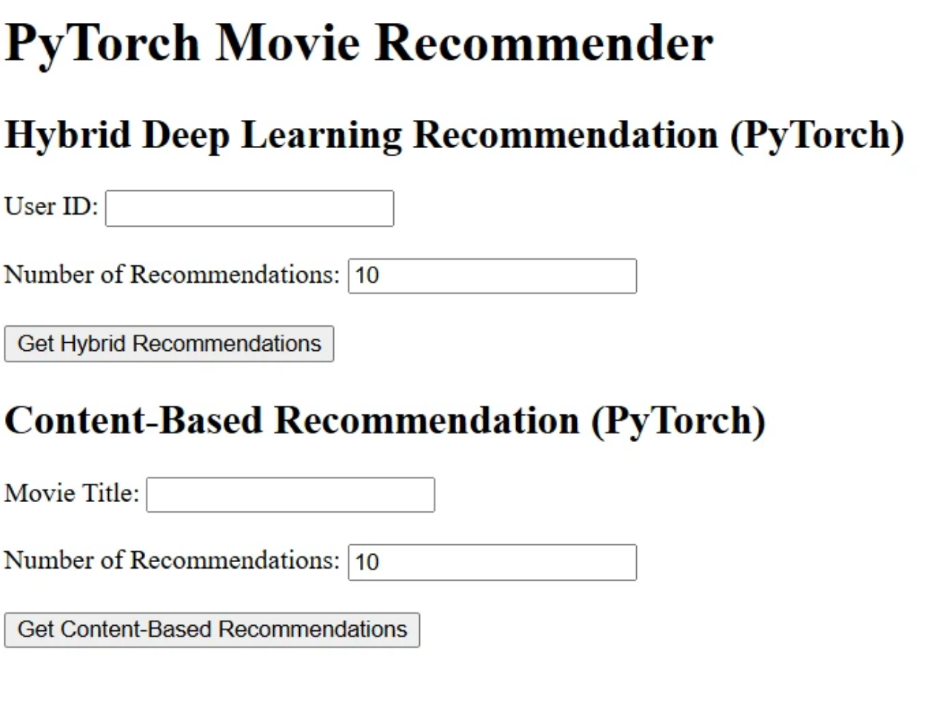
Screenshots
The Flask app has a simple web page where users can enter their ID or a movie title to get recommendations. It shows a form for input and lists the suggested movies with their predicted ratings or similarity scores.

Slide 20
05
RESULTS AND DISCUSSION

Slide 21

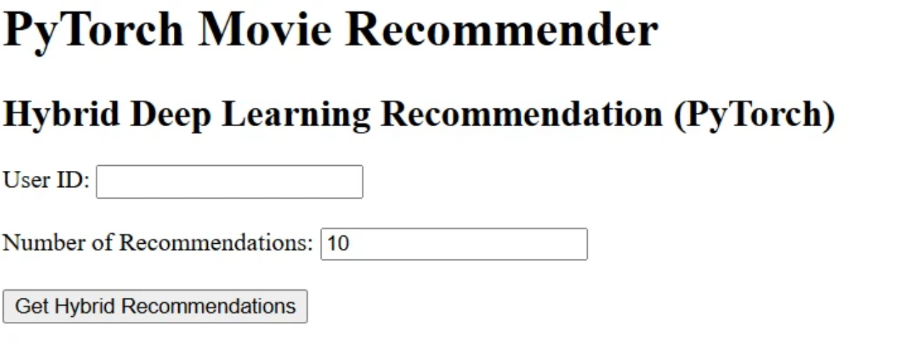
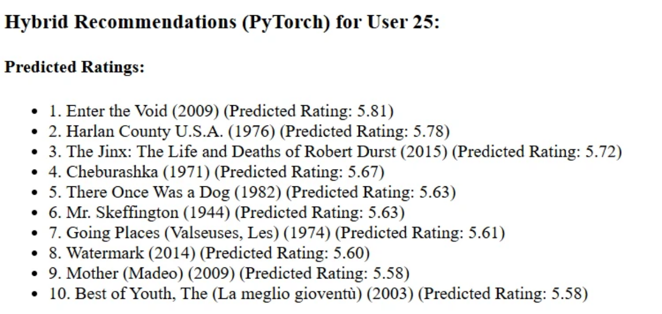
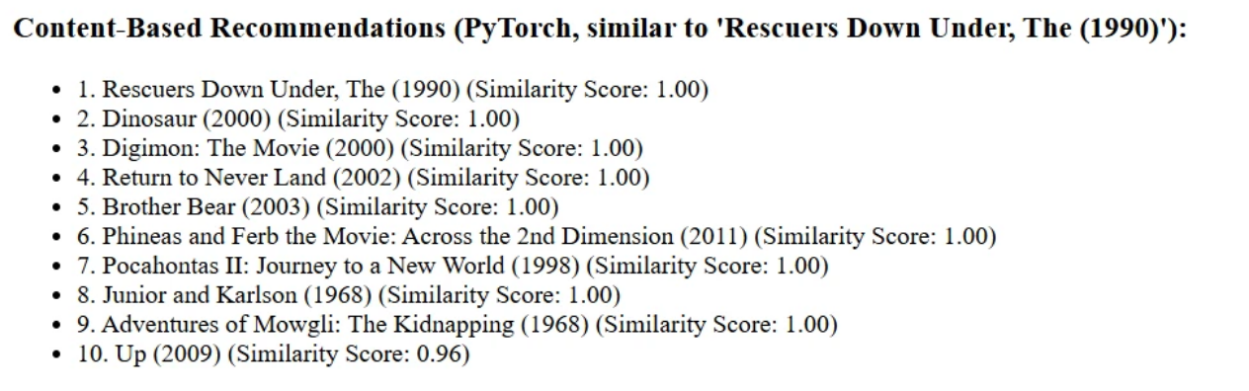
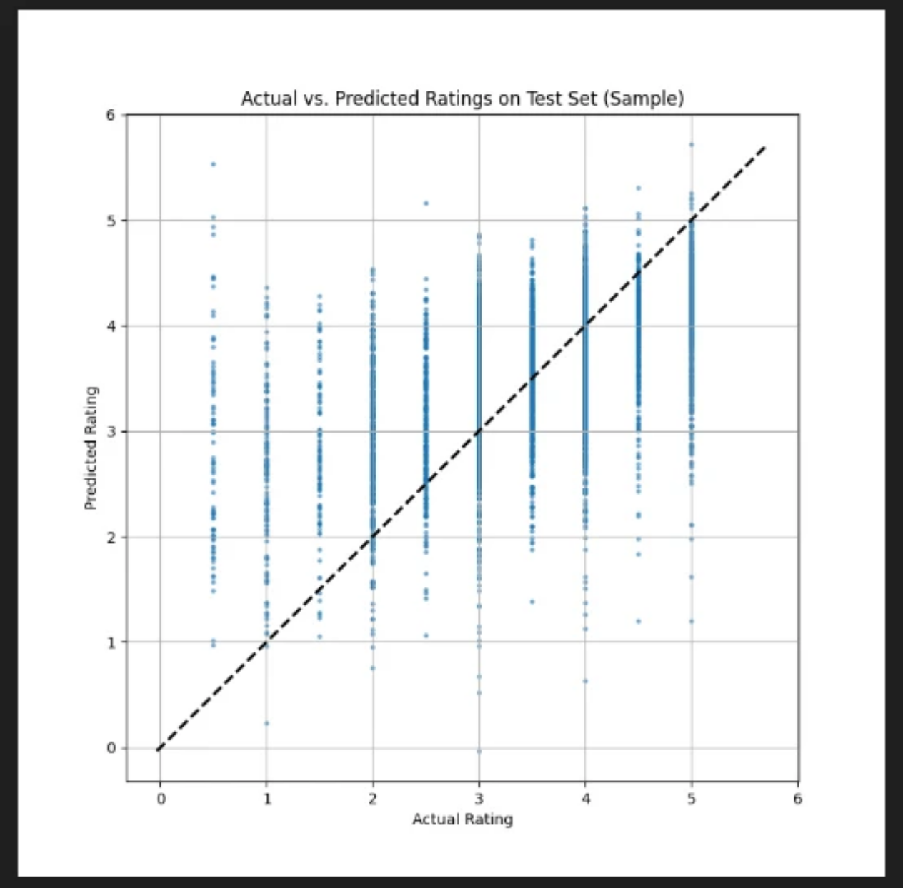
Output / Report
The system works great and does two things:
• Personalized Recommendations: Suggests the top N movies for a user based on their ratings.
Content-Based Recommendations: Finds movies similar to one I pick, like an anime movie, by looking at genres or descriptions.
Here’s a graph showing how close the model’s predictions are to actual ratings:

Slide 22

Challenges Faced
Building the project had some tough moments:
Data Issues: Some movies in the MovieLens dataset were missing details, like descriptions.
Model Balance: Making the collaborative and content-based parts
work together was hard.
cold start problem : Most of the data hasn’t rated any movies yet, the
system doesn’t know their preferences

Slide 23

Learnings
This project taught me a lot:
• How to build recommendation systems using machine learning.
• How to use PyTorch to create neural networks that predict things like movie ratings.
• How to make a web app with Flask so others can use my system easily.
• How to check if a model is good using numbers like MSE, MAE, and RMSE.
• How to handle data problems and finish a project from start to end.

Slide 24

06
CONCLUSION

Slide 25

Summary
The summer course "Machine Learning Made Easy: From Basics to AI Applications" at Lovely Professional University was awesome.
I learned how to use machine learning to solve real problems, and I built a movie recommendation system that suggests movies based on what users like or what’s similar to other movies.
The course taught me how to use Python, PyTorch, and other tools to make this happen.
I’m proud of my project because it’s useful for people like me who love movies and anime.
The Flask web interface makes it easy to use, and the model gives good suggestions.
This experience has made me more confident in machine learning, and I’m excited to work on more projects in the future.

Slide 26

Thank You

